Slide 1
The ChapR
Add the kawaii pic from the website

Slide 2
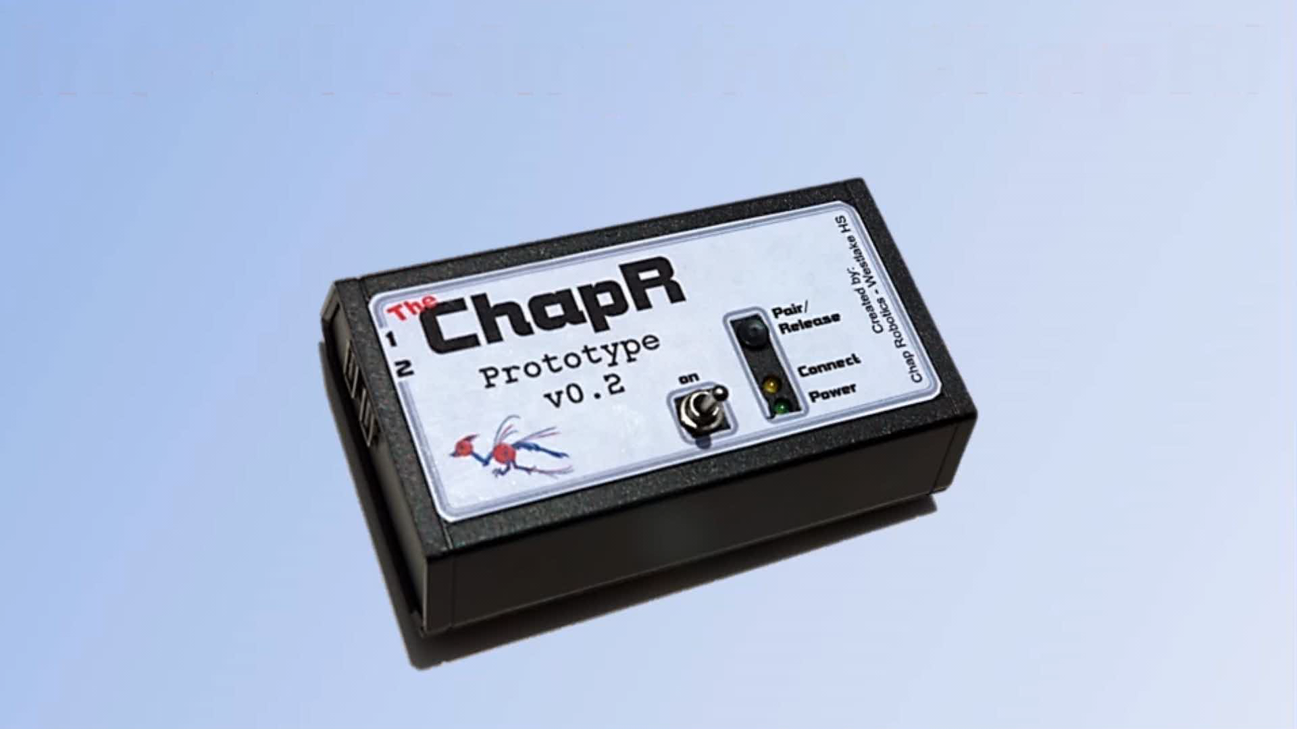

Slide 3
Features/Demo

Slide 4
Pairing
Via Bluetooth
Hold down both buttons on the ChapR
Use NXT menus to find the ChapR and connect with it

Slide 5
Pairing Continued
Via USB
Make sure Bluetooth is on
Plug in the cable

Slide 6
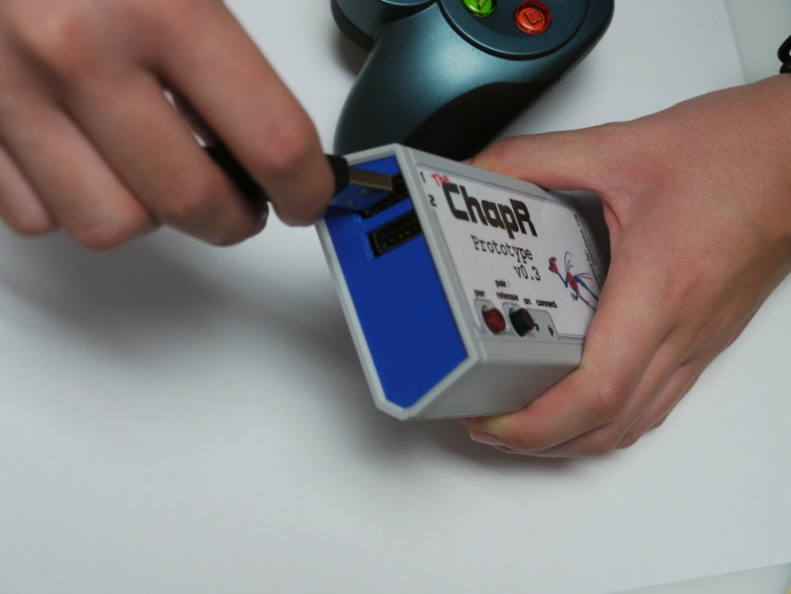
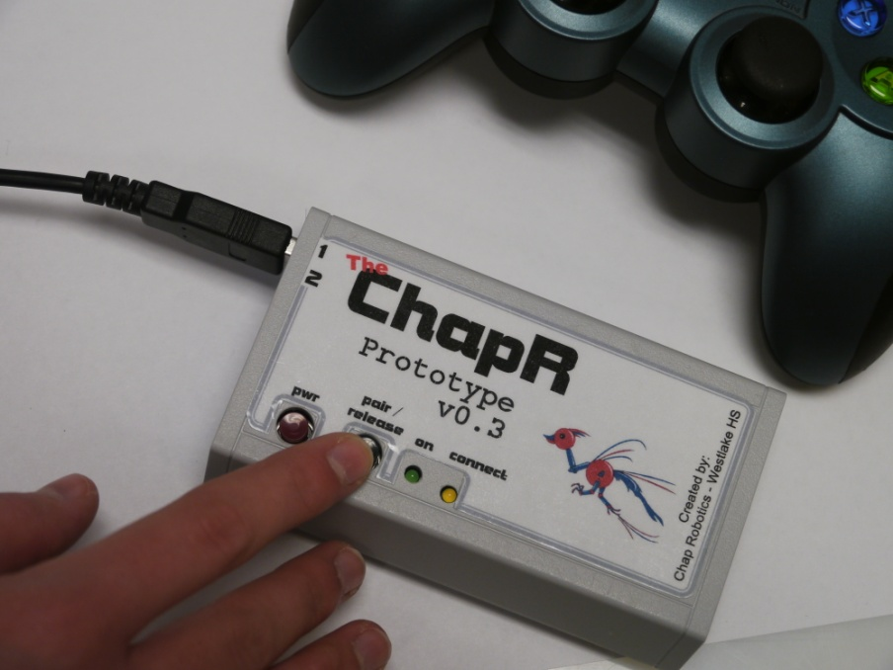
Driving
Plug in joysticks
Hit the WFS button if needed

Slide 7
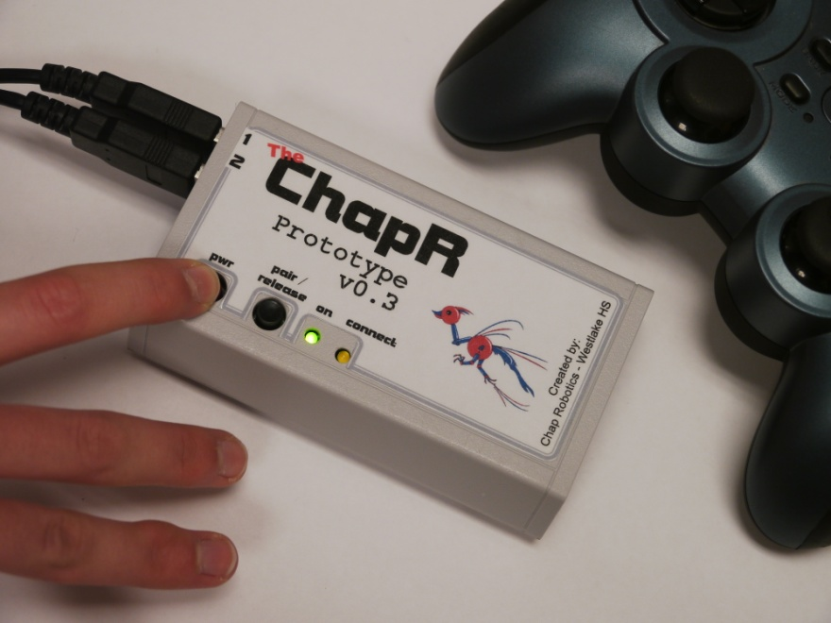
Driving
Hit power button to abort program

Slide 8
Configurable
name - the name of the ChapR as viewed by devices searching via Bluetooth (usually the NXT); must be under 15 characters; default is ChapR-whichever number ChapR you could (ex: ChapR-14)
personality - the compatibility of the ChapR; default is 1 (NXT-RobotC); click here to view details
timeout - the time before the ChapR turns itself off to save battery in minutes; 0 means no timeout; 120 minutes is the maximum; default is 10 minutes
lag - the time between sending messages; lag can be built in to simulate competition-style driving; click here for more information
mode - tele-op or autonomous; click here for more detailed information

Slide 9
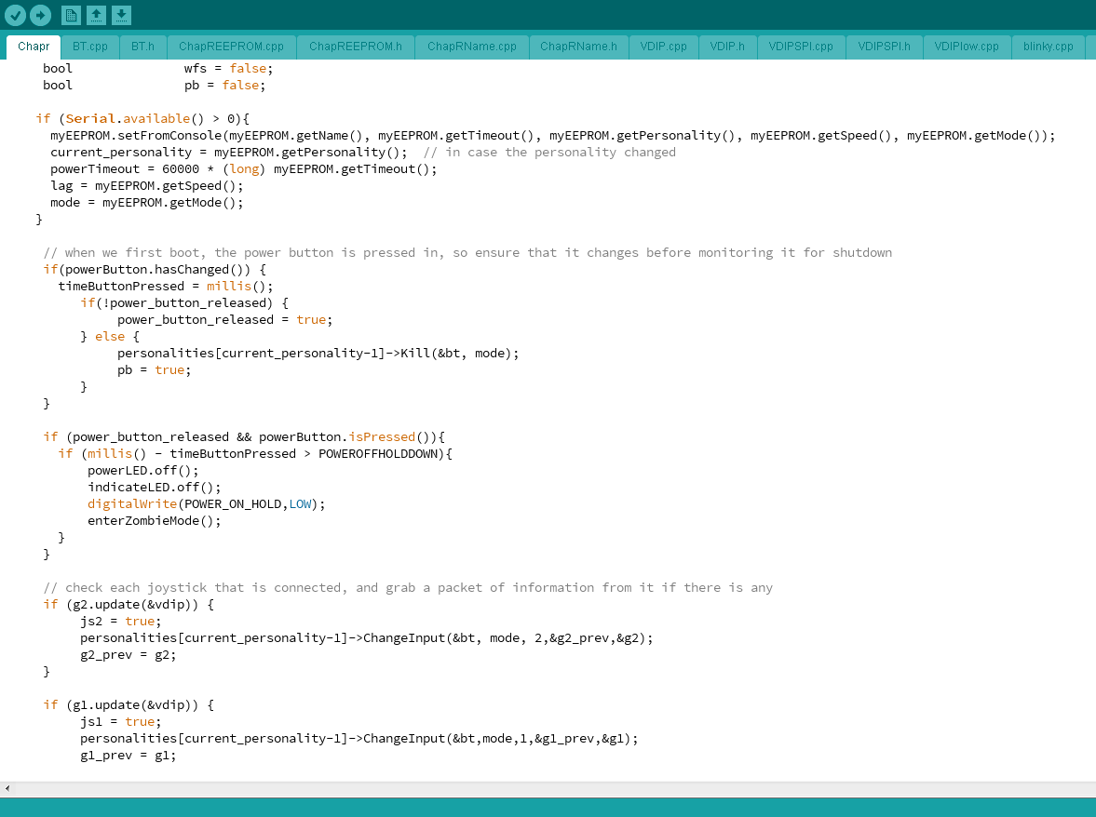
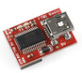
Programmable
The programmer and code on our website can be used to reprogram the ChapR

Slide 10
The Hardware
Arduino Pro-Mini
RN-42
VDIP

Slide 11
The Software

Slide 12
Moving Forward

